Slide 1
Advanced supporting structural systems of RC buildings for resisting large seismic motions

Slide 2
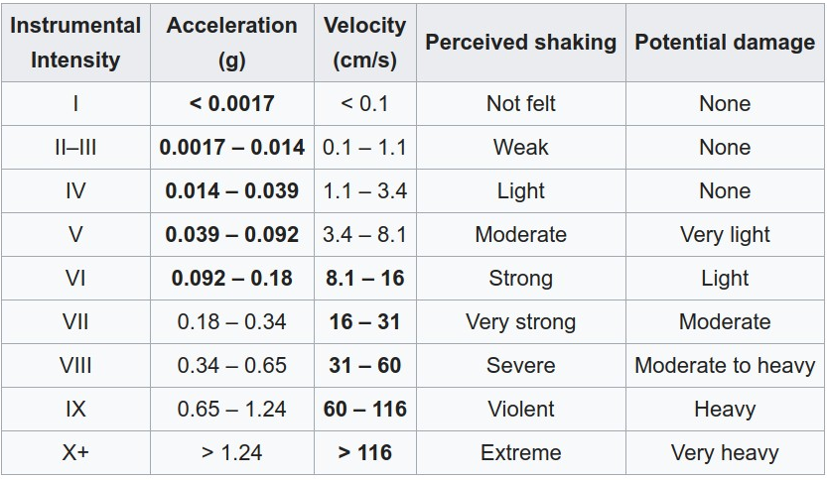
After the major seismic event which occurred in Turkey (2023), An effective and advanced approach to mitigate the destructive effects of earthquakes was discovered using the proper enforcement of the knowledge that is currently available for designing, constructing, and maintaining new earthquake-resistant structures and upgrading existing seismically hazardous structures.
Defining table for intensity of earthquakes (Acceleration of gravity = 9.81 m/sec2)

Slide 3
Global seismic hazard map of the world

Slide 4
Comparison between RC building without & with supporting against earthquake have intensity 7.6 Richter (first supporting system)
Six floors RC building without supporting

Slide 5
Six floors RC building with supporting

Slide 6
The columns are the main support of the buildings therefore comparison were carried out for column sections
 | Intensity of earthquake (Richter) | Moment of column section in the direction of X (Mx, t.m) | Moment of column section in the direction of Z (Mz, t.m) | Ratio of reduction due to supporting for Mx (%) | Ratio of reduction due to supporting for Mz (%)
Straining actions on without supporting | 7.6 | 227 | 152 | 72.33 | 50.92
Straining actions on with supporting | 7.6 | 62.8 | 74.6 | 72.33 | 50.92

Slide 7
Comparison between RC building without & with supporting against earthquake have intensity 8.6 Richter (other supporting system – Second supporting system)
Six floors RC building without supporting

Slide 8
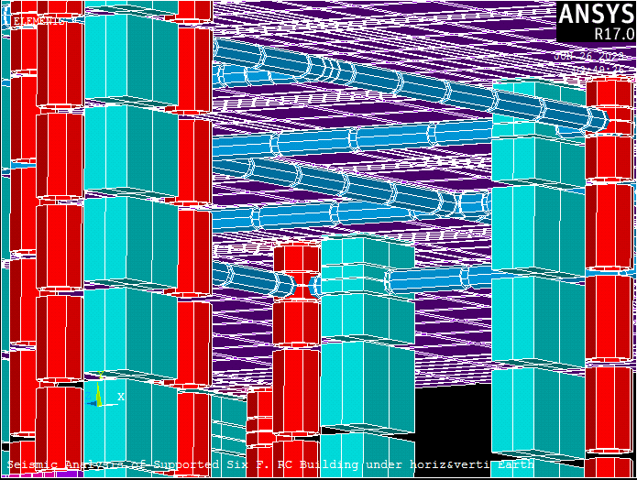
Six floors RC building with supporting

Slide 9
The columns are the main support of the buildings therefore comparison were carried out for column sections
Straining actions ( Drift & Moments) of columns | Drift in Dir. X (cm) | Drift in Dir. Z (cm) | Moment in X – Dir. Mx (t.m) | Moment in Z – Dir. Mz (t.m) | Average Reduction factor R (%)
External Column (Without supporting) | 51.2 | 40.7 | 12.74 | 8.5 | 53.7
External Column (With supporting) | 33 | 26.7 | 4 | 2 | 53.7
Internal Column (Without supporting) | 51 | 40.7 | - | - | 40.3
Internal Column (With supporting) | 32 | 23 | - | - | 40.3

Slide 10
Comparison between RC building without & with supporting against earthquake have intensity 9.3 Richter (other supporting system – Third supporting system)
Six floors RC building without supporting

Slide 13
comparison were carried out for column sections
Straining actions ( Drift & Moments) of columns | Drift in Dir. X (cm) | Drift in Dir. Z (cm) | Moment in X – Dir. Mx (t.m) | Moment in Z – Dir. Mz (t.m) | Average Reduction factor R (%)
External Column (Without supporting) | - | - | 12.74 | 8.5 | 59
External Column (With supporting) | - | - | 6 | 2.9 | 59
Internal Column (Without supporting) | 51 | 40.7 | 12.7 | 8.5 | 40.3
Internal Column (With supporting) | 7 | 0.3 | 0.3 | 5.3 | 80

Slide 14
From the previous presentation of the different supporting structural systems and also its results under seismic actions (7.6, 8.6, 9.3 Richter) it should be recommended to start directly in executing these supporting for the buildings that are at risk in order to protect them against earthquakes.

Slide 15
The work of construction accounts ( program Anasys ) A group of university professors and specialists in earthquake research
Presented By
The design idea of ​​the reinforcement method.
Consultant Engineer
ARC / Mohamed Abdel Moneim Mohamed

